Slide 1
BUSINESS REPORT RALLI MOTORS
Nandhini Gopinath
Ponny Babu
03/26/2019

Slide 2
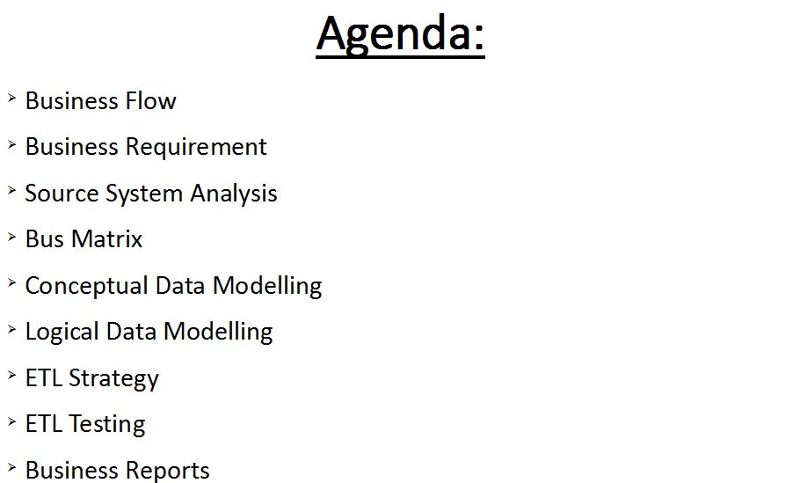

Slide 3
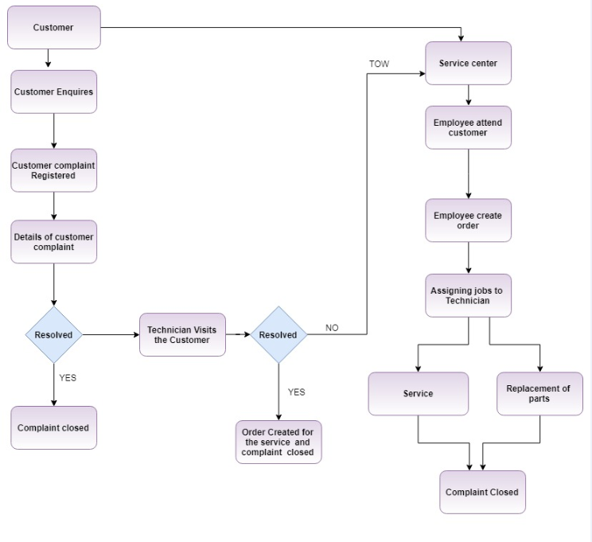
Business Flow

Slide 4
Business Requirements
Handle
Handle Service duration delay
Identify
Identify Repeated Symptoms
Improve
Improve Customer Satisfaction

Slide 5

Source System Analysis
Process of reviewing source data, understanding structure, content and interrelationships, and identifying potential for data projects

Slide 6
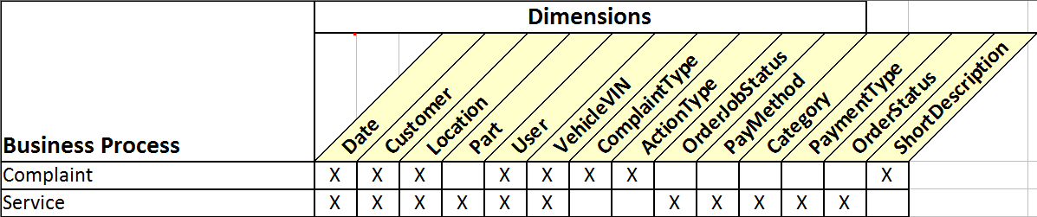
BUS MATRIX

Slide 7
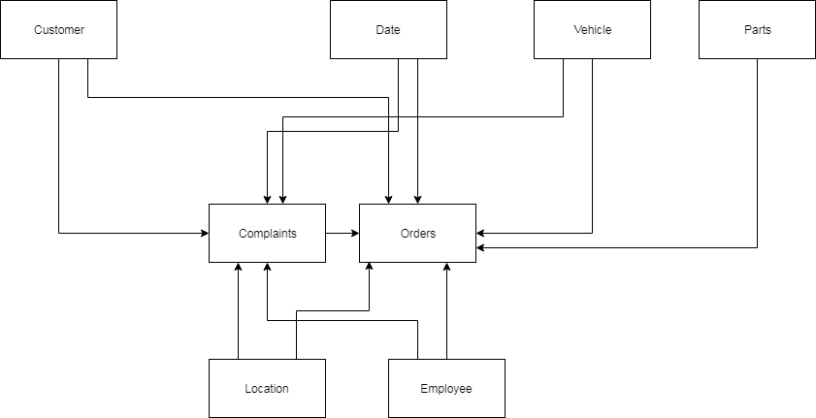
CONCEPTUAL DATA MODELLING

Slide 8
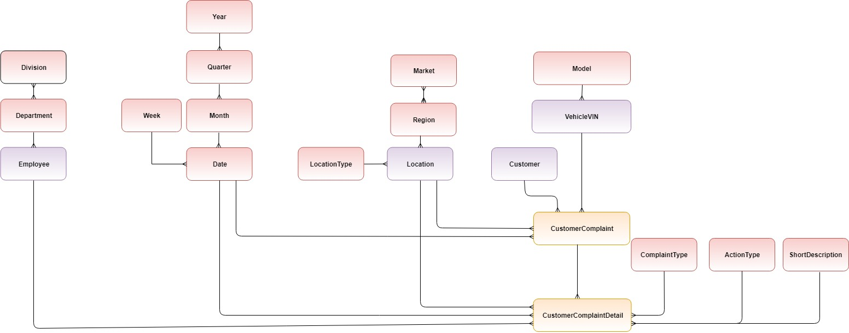
LOGICAL DATA MODELLING

Slide 9
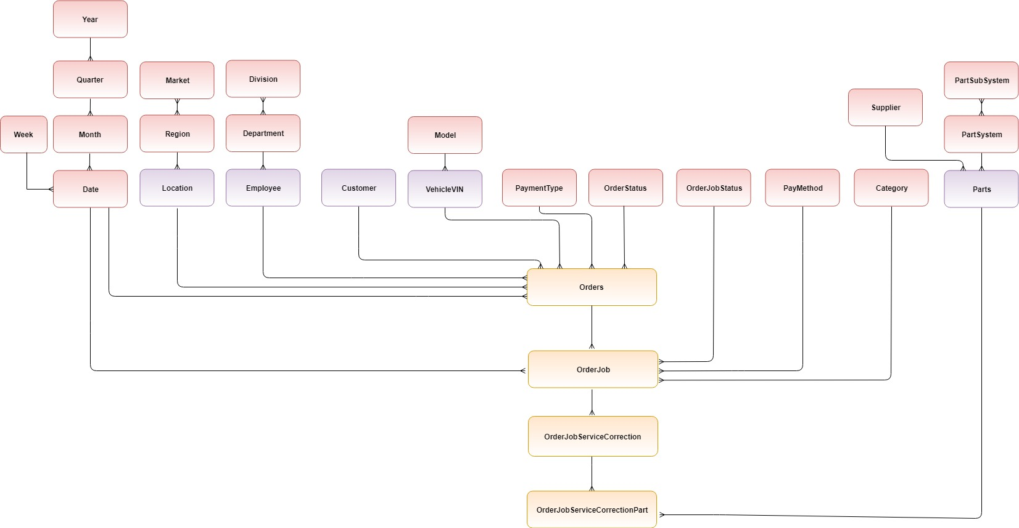
LOGICAL DATA MODELLING

Slide 10
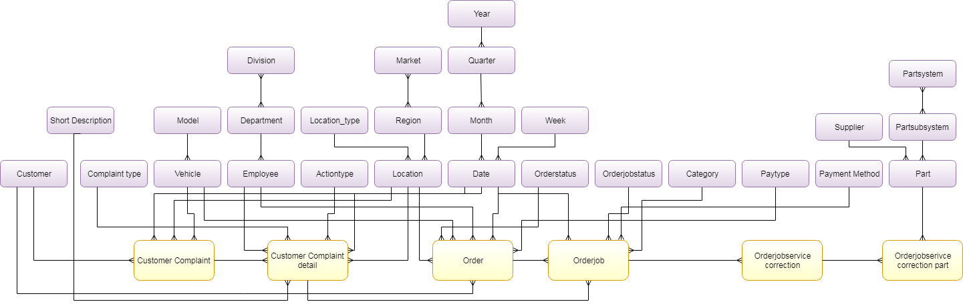
LOGICAL DATA MODELLING

Slide 11
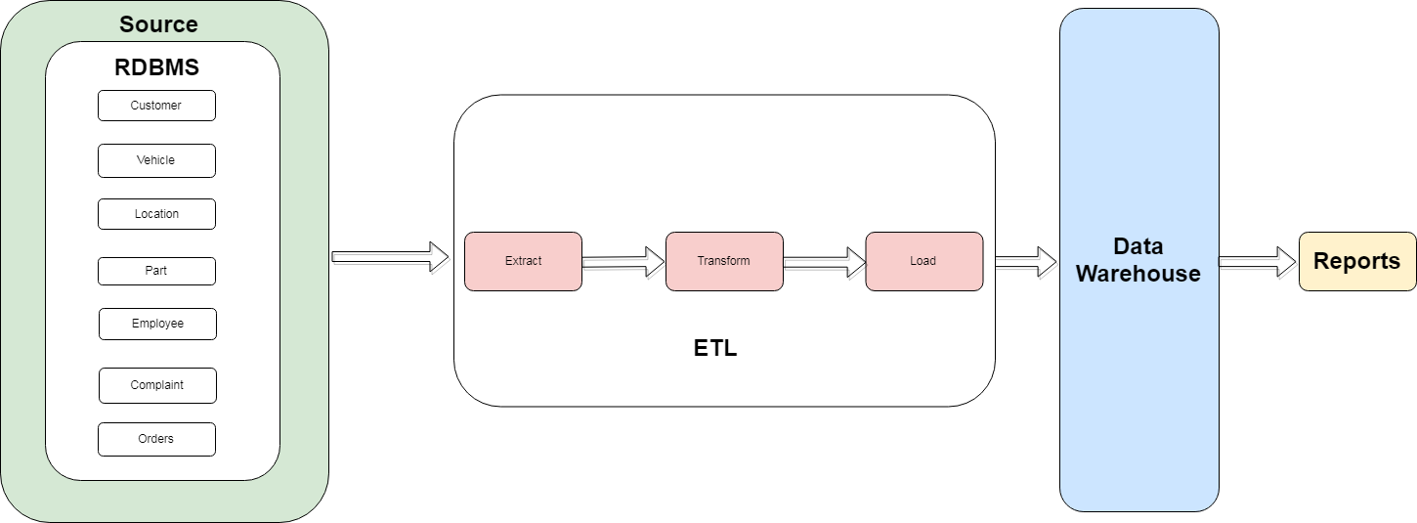
ETL STRATEGY

Slide 12
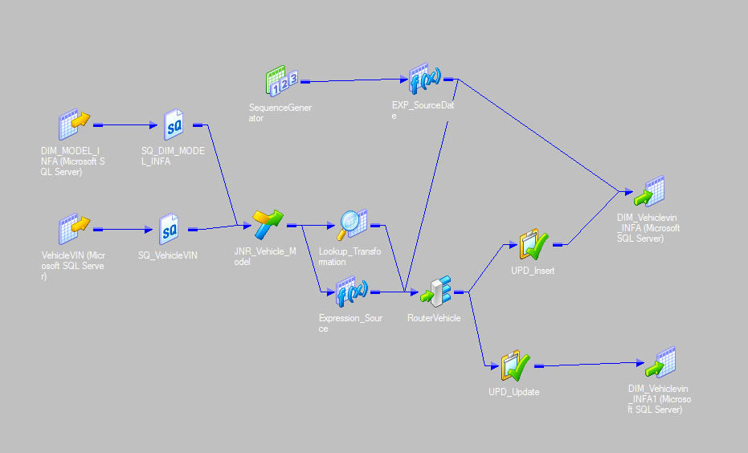
ETL DIMENSION TABLE MAPPING

Slide 13
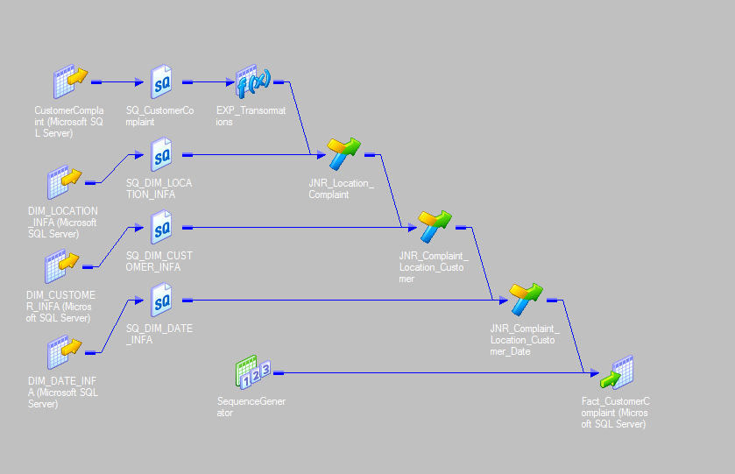
ETL FACT TABLE MAPPING

Slide 14
ETL TESTING
ETL testing is done to ensure that the data that has been loaded from a source to the destination after business transformation is accurate.

Slide 15
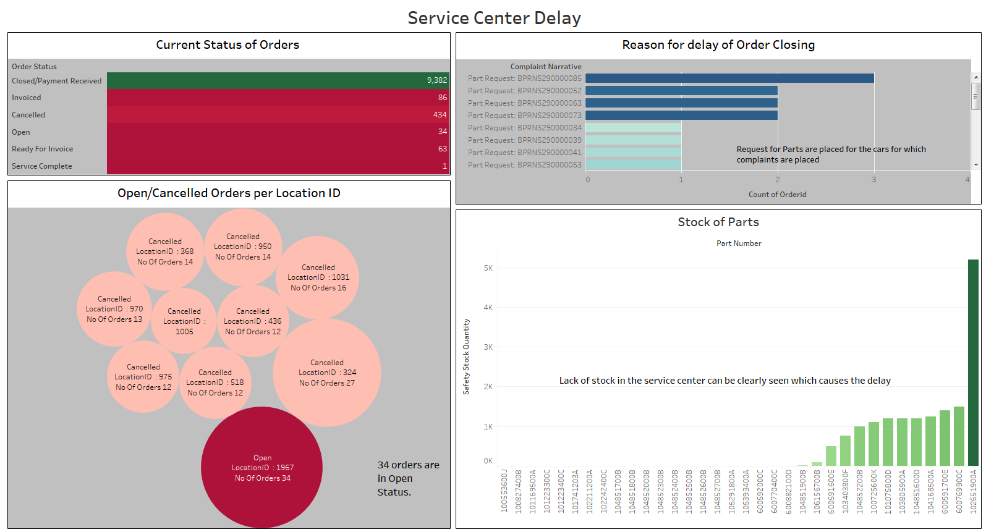

Slide 16
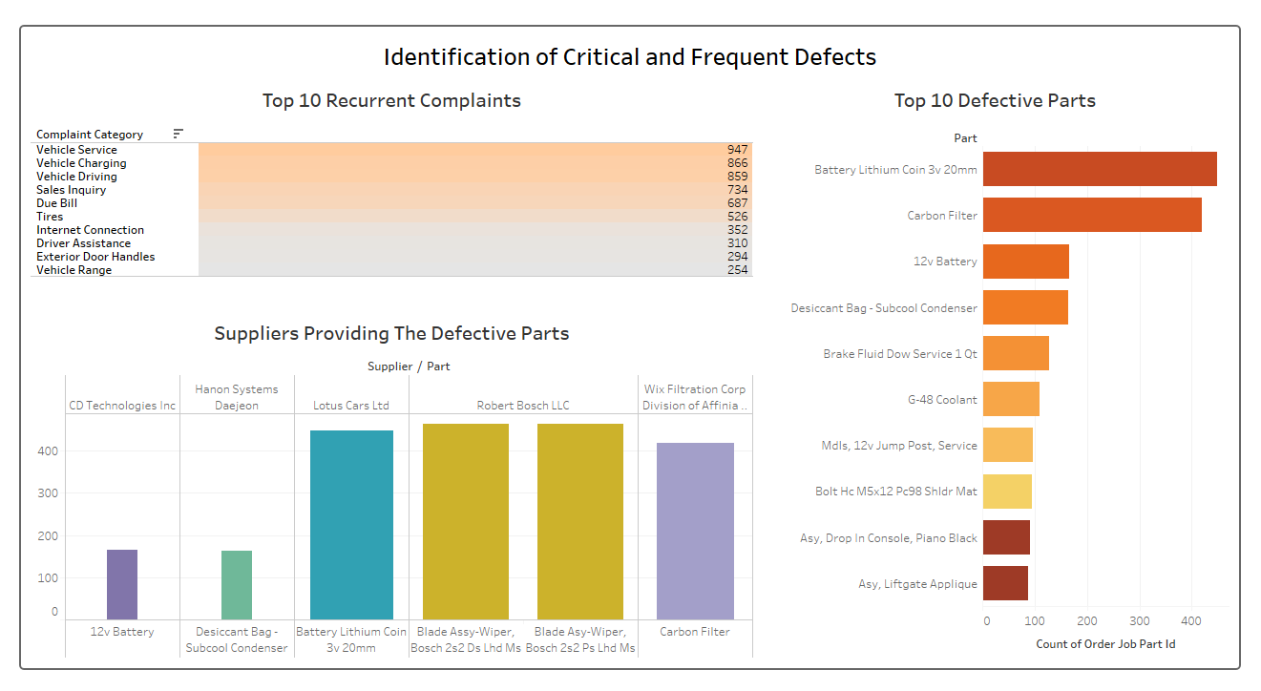

Slide 17
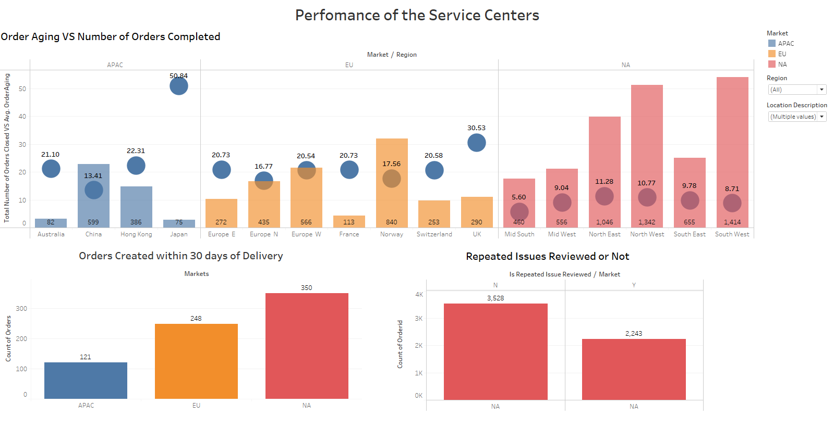

Slide 18
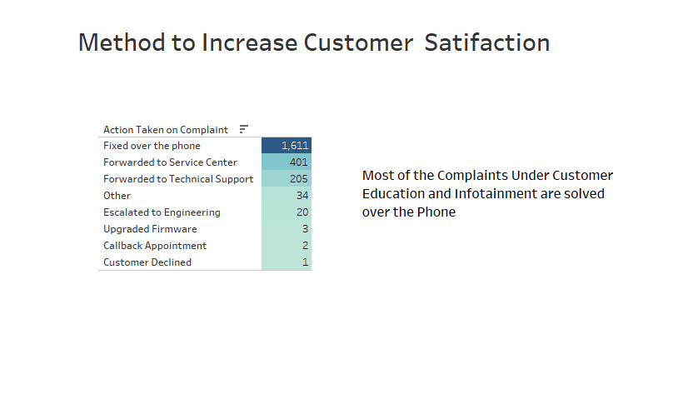

Slide 19
THANK YOU

Slide 20
Documents
STTM
ETL: Test Case
PDM
ETL : Pseudocode
Report : Test Case

